Slide 1
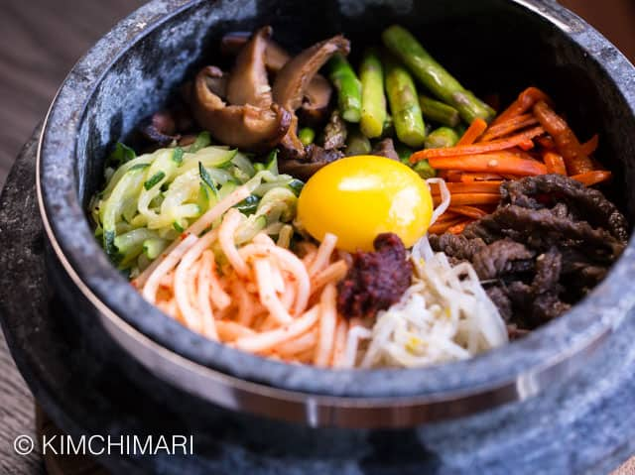
Home
About us
Menu
Gallery
Contact
U-TOWN
ENJOY THE BEST AUTHENTIC KOREAN CUISINE AT u-TOWN!
We serve the best Korean dishes. Our restaurant offers bibimbap, various hot pots, barbecue meats, chicken dishes, and potstickers. Served with rice and side dishes. A selection of K-pop music completes the atmosphere in our restaurant. We offer dine-in service and takeout. We hope to see you soon.

Slide 2
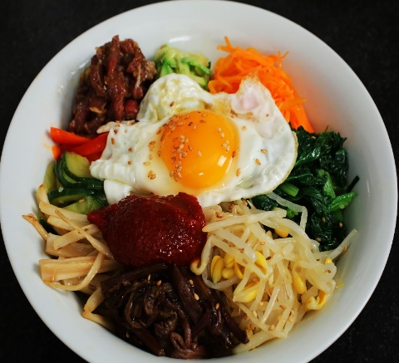
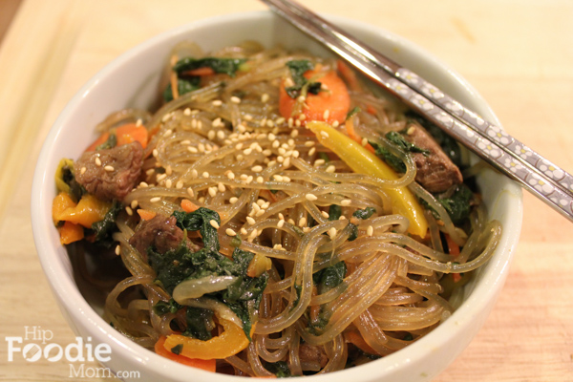
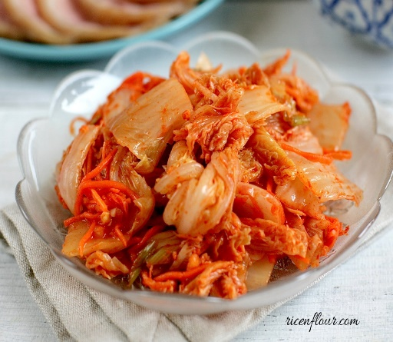
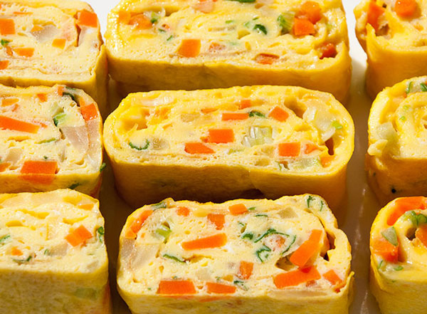
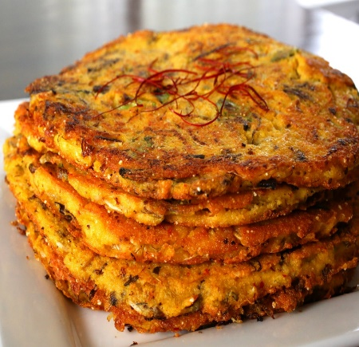
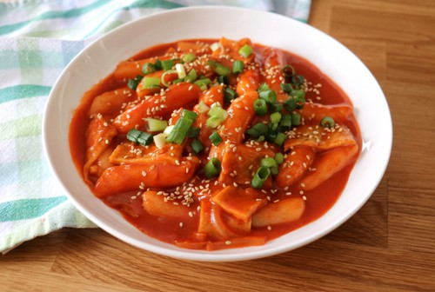
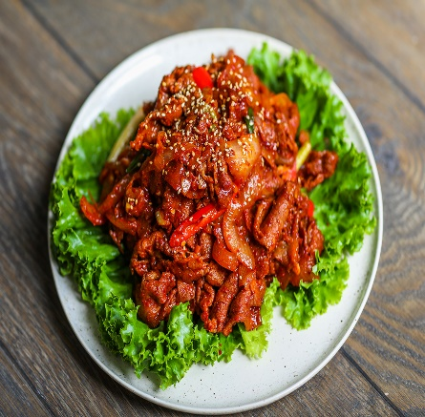
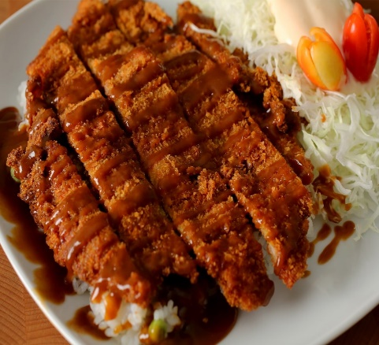
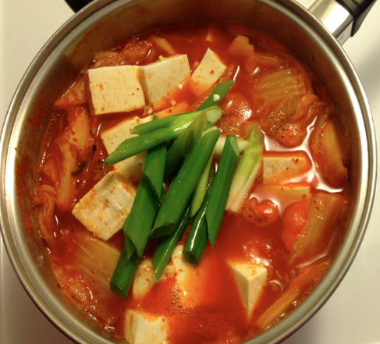
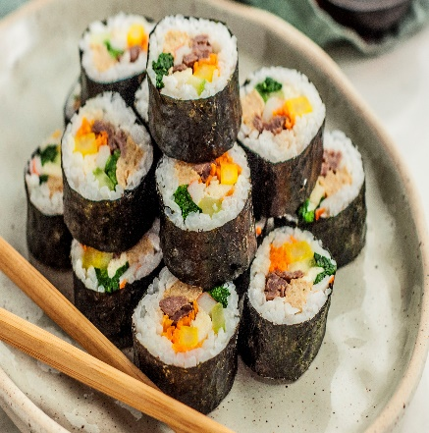
MENU
3.Chapchae \700
7. Korean Egg Roll \750
9.Bindaettok \650
1.Bibimbap \900
5. Kimchi \500
2.Tteobokki \650
4. Pork Bulgogi \800
8. Kimchi Stew \750
6.Donkkaseu(Pork cutlet)
\880
10.Kimbap \700

Slide 3
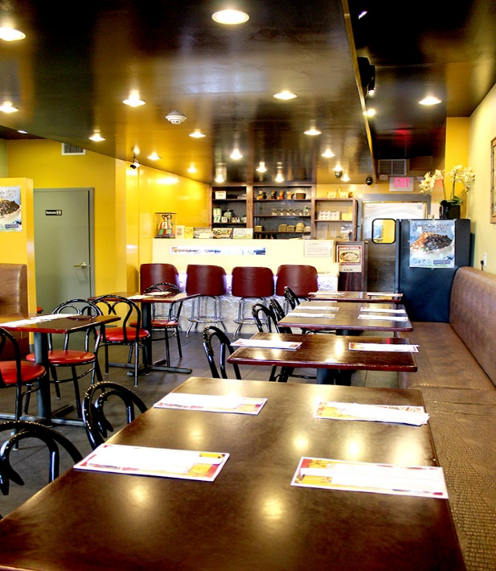
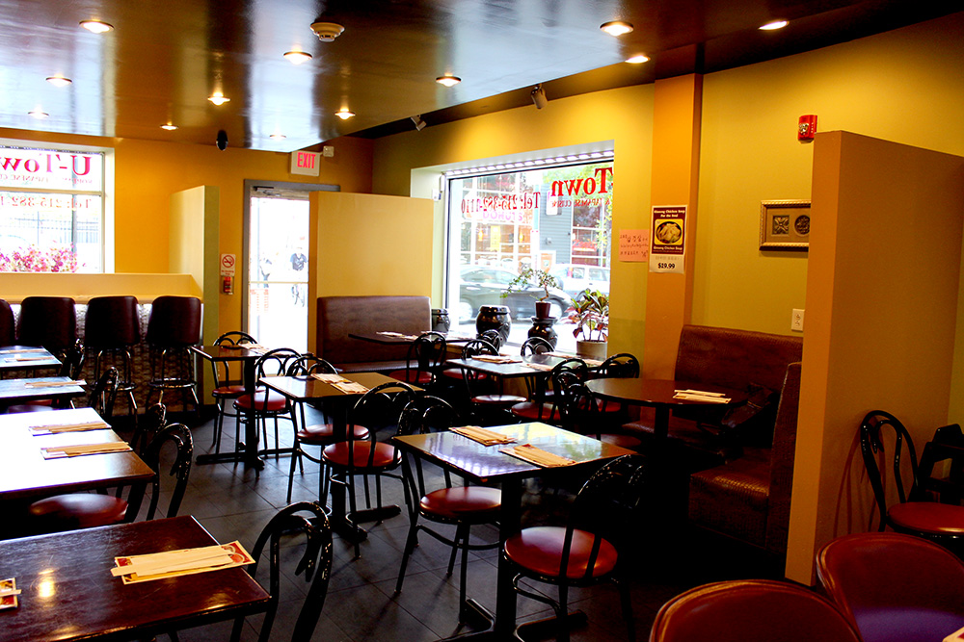
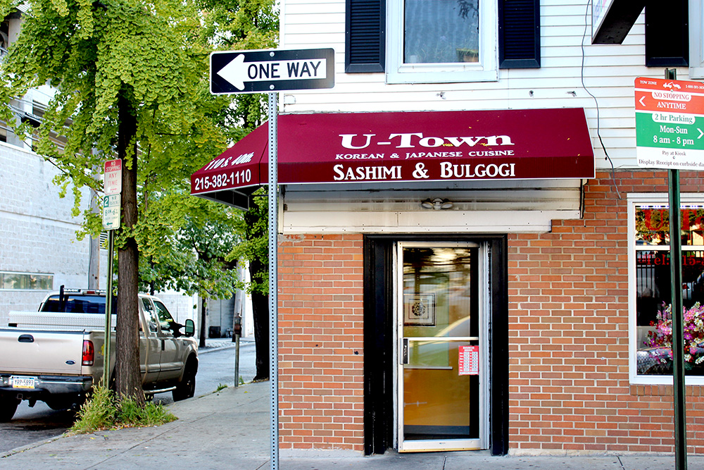
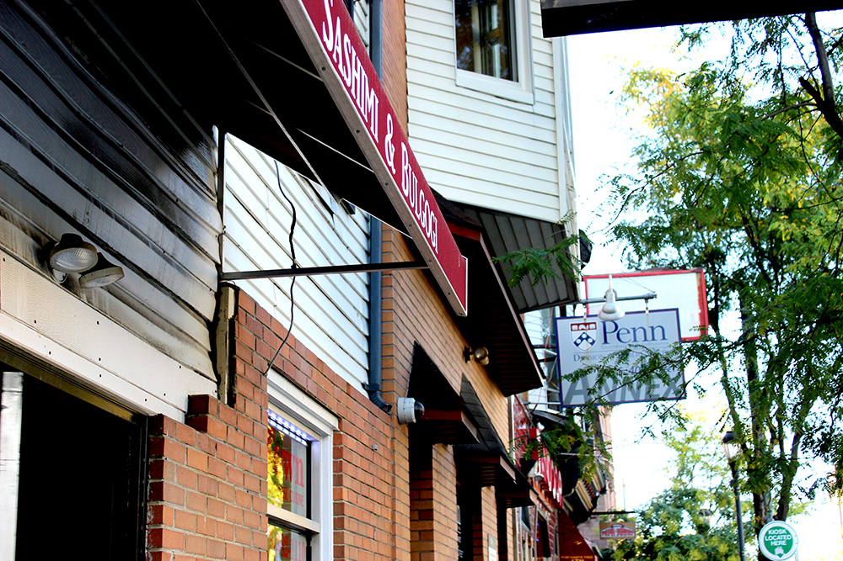
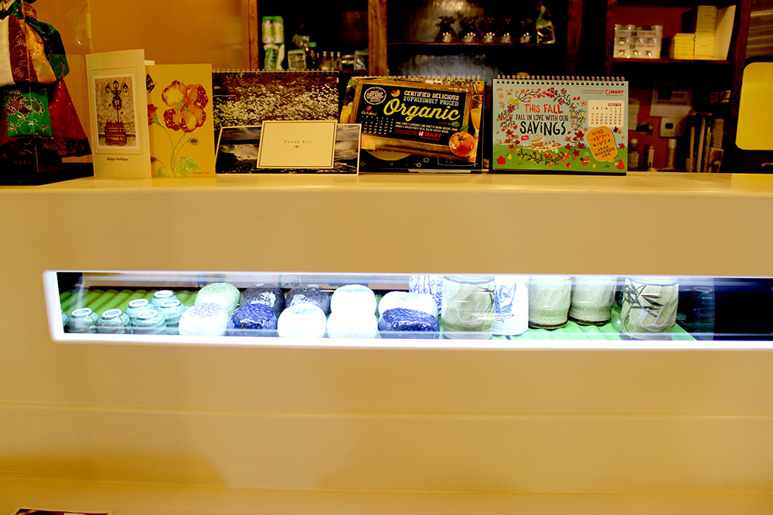
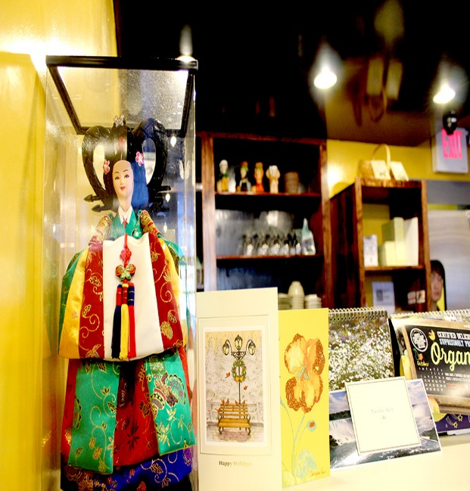
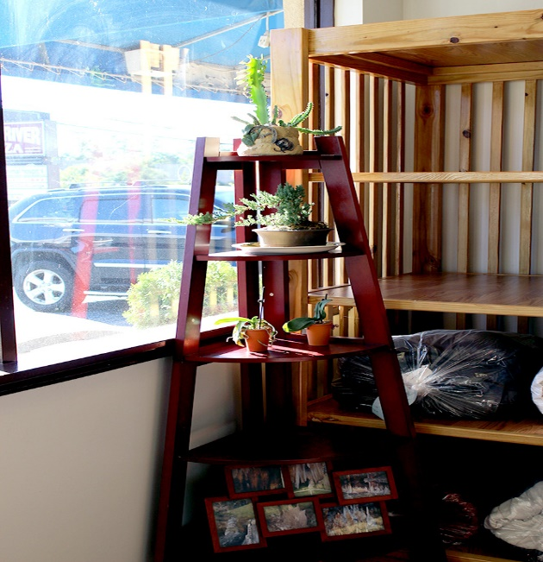
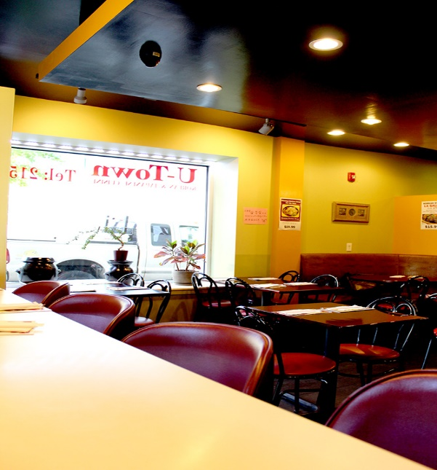
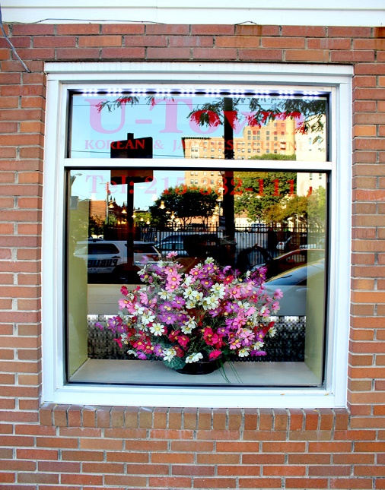
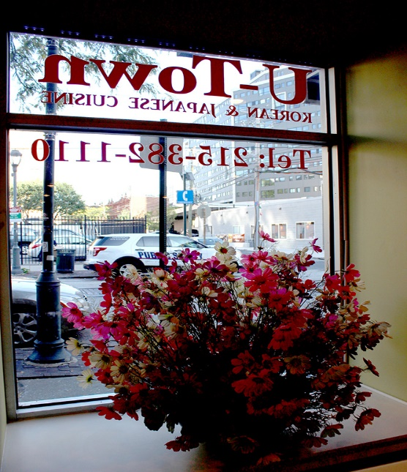
GALLERY

Slide 4
CONTACT US
…………………………
110 S.40th Fukuoka 19104
215-382-1110
Hours
Monday ~ Saturday
11:00 am ~ 10:00 pm
SundayClosed *We close on Dec. 24th, 25th, 26th & 27th for Holidays. We will re-open on 28th!
*We open on Dec. 31st and Jan. 1st New Years Day!
Call
215-382-1110
…..............................

